Slide 1
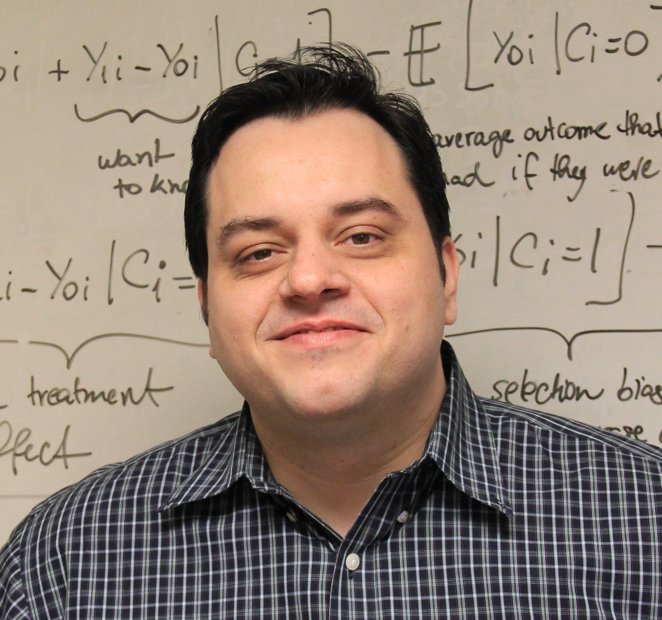
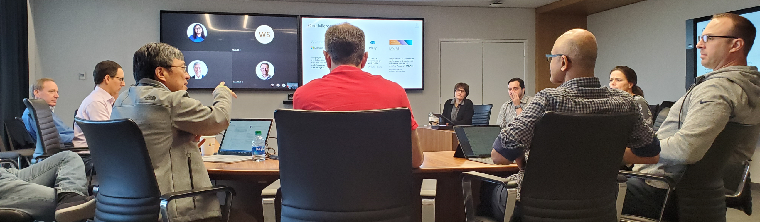
About me
B. Sc. Computer Sciences ‘01 (Universidade de São Paulo, Brazil)
University of Washington TMMBA’10, MSc Finance’14 (ABD)
At Microsoft since 2002
Twitter: @lucas_a_meyer
LinkedIn: lucasameyer
Email: lucas.meyer@microsoft.com

Slide 2
About Global Financial Solutions
Collections
> $120B
~ 20% YoY increase
>100k
Active
customers
~100 FTEs
+1000 BPO
>90%
<0.05%
Current
Losses
Notes:
The World-Wide Credit Services organization is responsible for the management of Microsoft’s global credit risk and accounts receivable portfolio. Oversight for this $22 billion portfolio is carried out by teams based in Redmond, Reno, Fort Lauderdale, Manila, Buenos Aires, Dublin, Budapest, Chennai, Gurgaon, Johannesburg, Singapore, Seoul, and Beijing. World Wide Credit Services provides services for all of Microsoft’s major business segments in support of the order-to-cash-cycle and partners with the Treasury Organization to maximize cash flow in support of the lifecycle of the dollar.

Slide 3

In my experience…
The main characteristic of a successful machine learning model are its economics
A machine learning model is either making/saving money or costing money
If you can show that your model has good economics, you’ll get plenty of resources

Slide 4
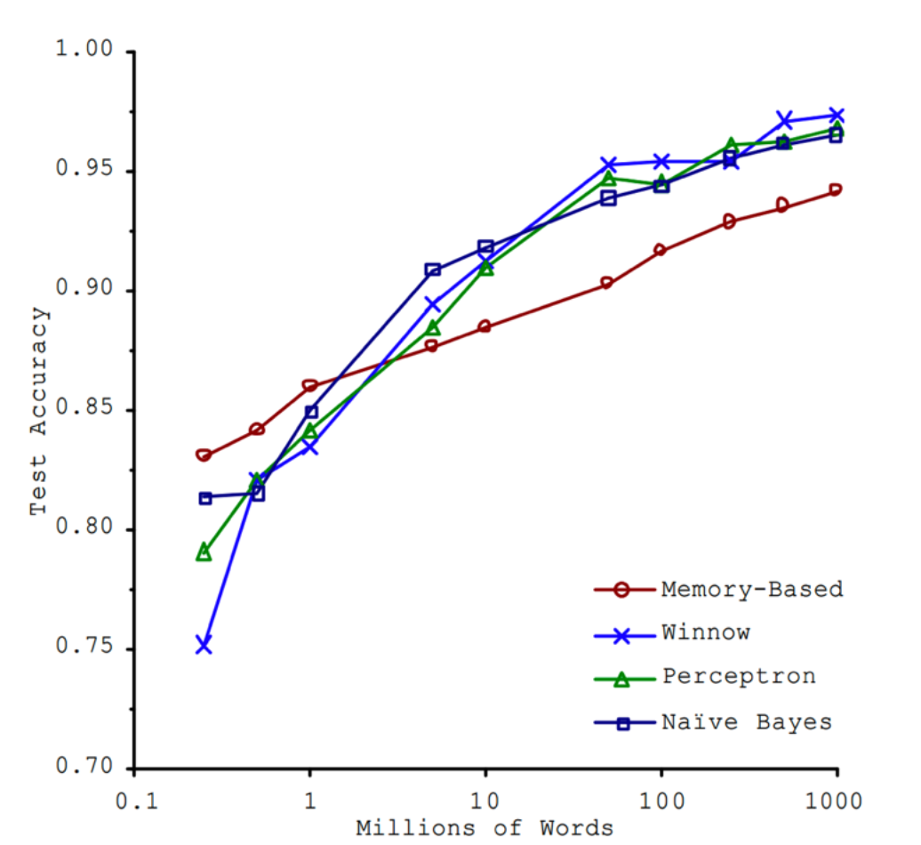
About “the unreasonable effectiveness of data”
The more data you have, the better your project will perform, even if you don’t choose the best algorithm.
The terminology changed over time:
Memory-based: e.g. KNN
Winnow: optimized perceptron
Perceptron: early neural network
Naïve Bayes: you probably know it
Source: Banko, Brill (2001) – Microsoft Research

Slide 5

Choosing successful projects
You have enough data
You know the baseline and think you can beat it
Beating the baseline provides economic value far in excess of the cost of your project
You should do it.

Slide 6


Thank you!

